Slide 1
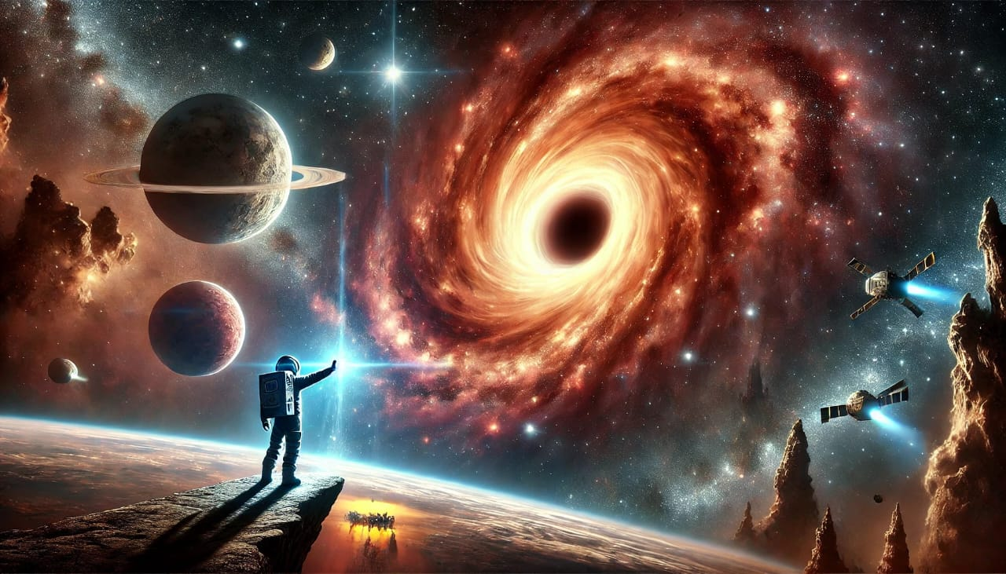
Exploring The Mysteries Of Space
Why Explore space ?
Challenges of Space Exploration
The Search for Extraterrestrial Life
Space Exploration Milestones
Space Phenomenon

Slide 2

I Have Choosen This Content From Google
Thank you
Presented by:
B.Sai Sushma
CSE-A
Roll no: 19

